Slide 1
SAP EWM EXTENDED WAREHOUSE MANAGEMENT TRAINING
AnubhavTrainings.com
www.anubhavtrainings.com

Slide 2

SAP EWM TRAINING
BY:-
Mr. Bijoy
www.anubhavtrainings.com
Notes:
https://unsplash.com/photos/uXB-7la5vqA

Slide 3
Mass upload
Mass upload of Bin master
Packspec
Bin sorting

Slide 4
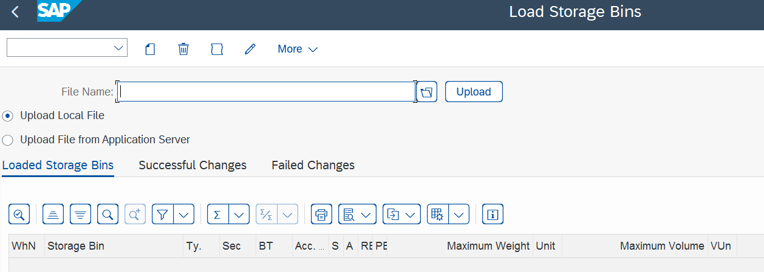
Mass upload process:
Mass upload for the Storage bin
Prepare the Excel file and save it as .CSV file type.
Upload the file using T-code: /SCWM/SBUP
www.anubhavtrainings.com

Slide 5
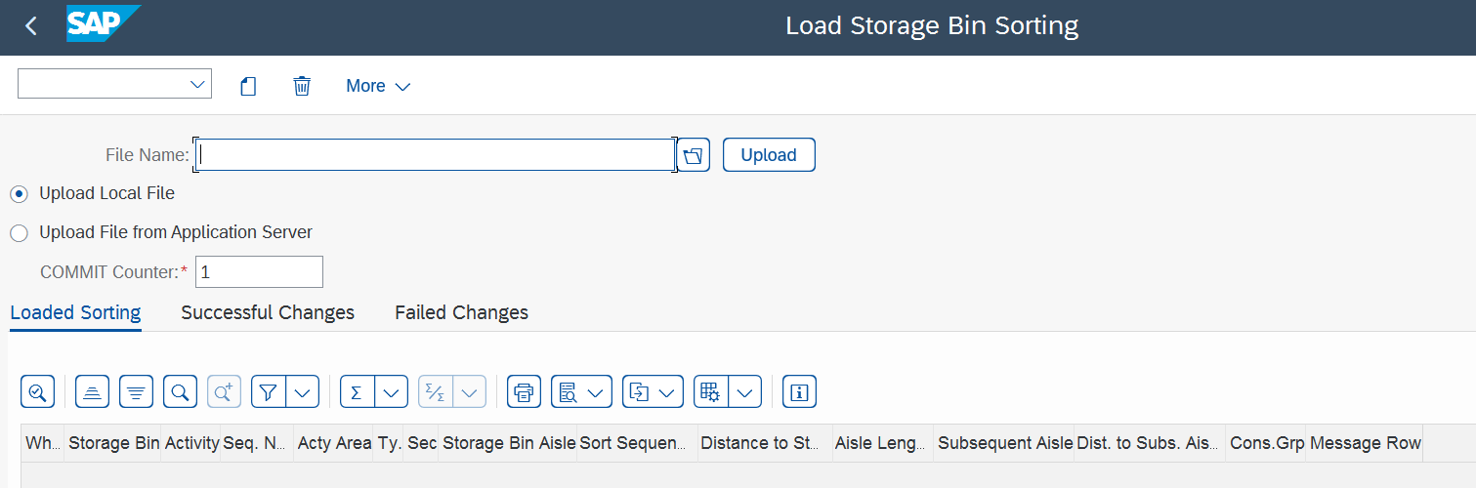
2.Mass upload for bin sorting
Prepare the excel file and save it as .CSV file type.
Upload the file using T-code: /SCWM/SRTUP
www.anubhavtrainings.com

Slide 6
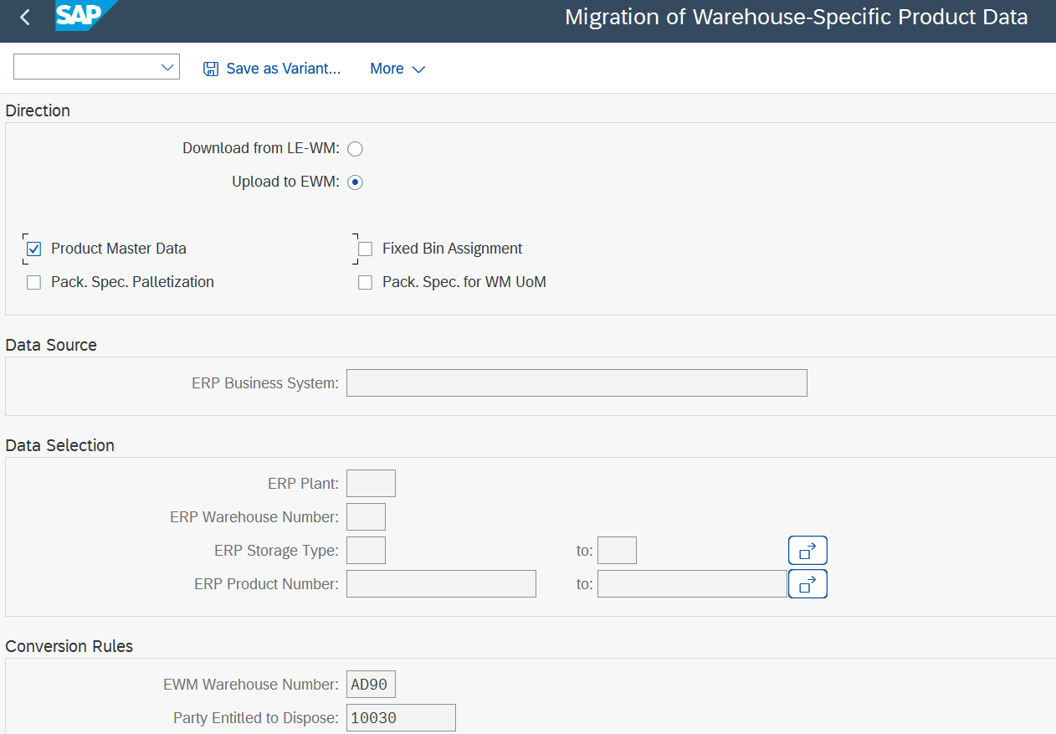
3.Mass upload for product extension
Prepare the excel file and save it as .CSV file type.
Upload the file using T-code: /SCWM/MIG_PRODUCT
www.anubhavtrainings.com

Slide 7
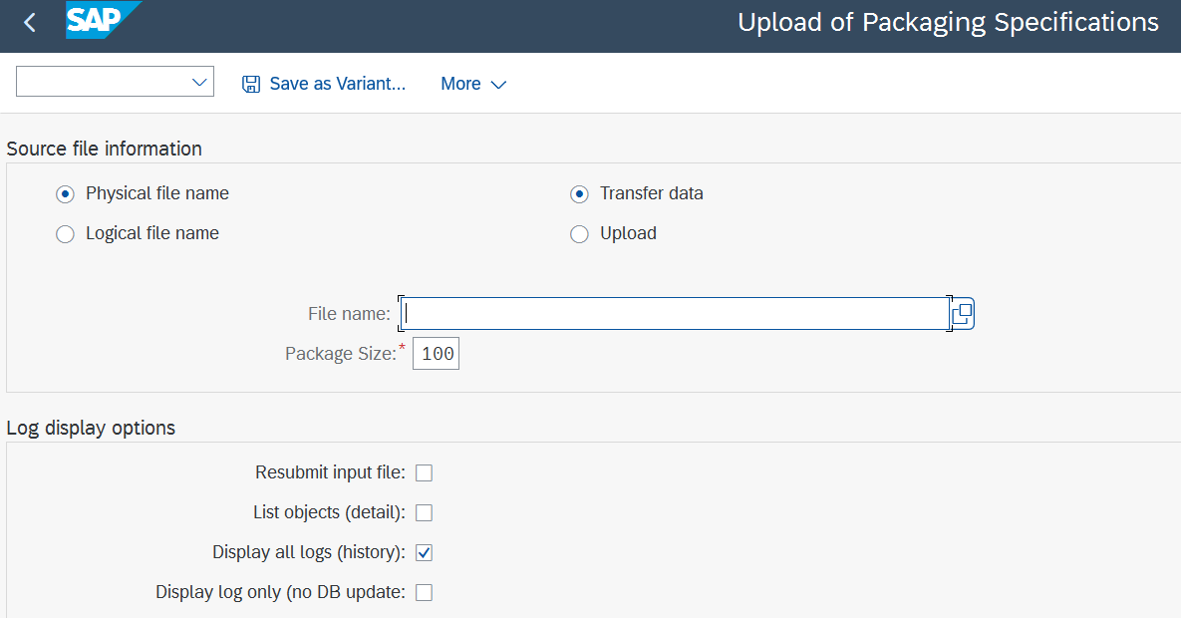
4. Mass upload packaging specification
Prepare the excel file and save it as .CSV file type.
Upload the file using T-code: /SCWM/IPU
Once you upload the packspec, activate it using T-code: /SCWM/PACKSPEC
www.anubhavtrainings.com

Slide 8
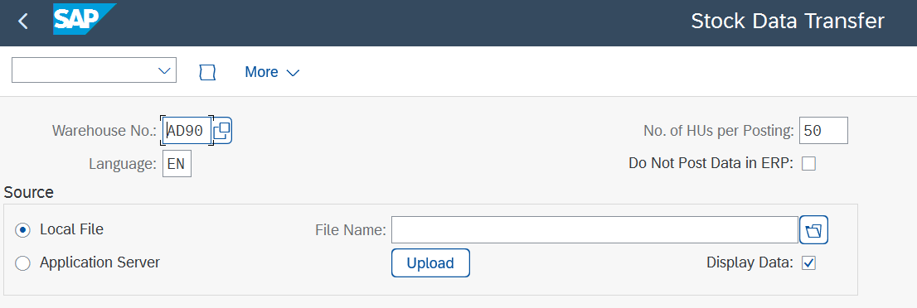
5.Mass upload for Initial stock upload
Prepare the excel file and save it as .CSV file type.
Upload the file using T-code: /SCWM/ISU
Once you upload your stock, it is important to check the stock overview in both the system (S/4 & EWM)
www.anubhavtrainings.com

Slide 9


End of Session
www.anubhavtrainings.com

Slide 10

FEEL FREE TO ASK QUESTIONS

Slide 11

Feedback

Slide 12
THANK
YOU

Slide 13

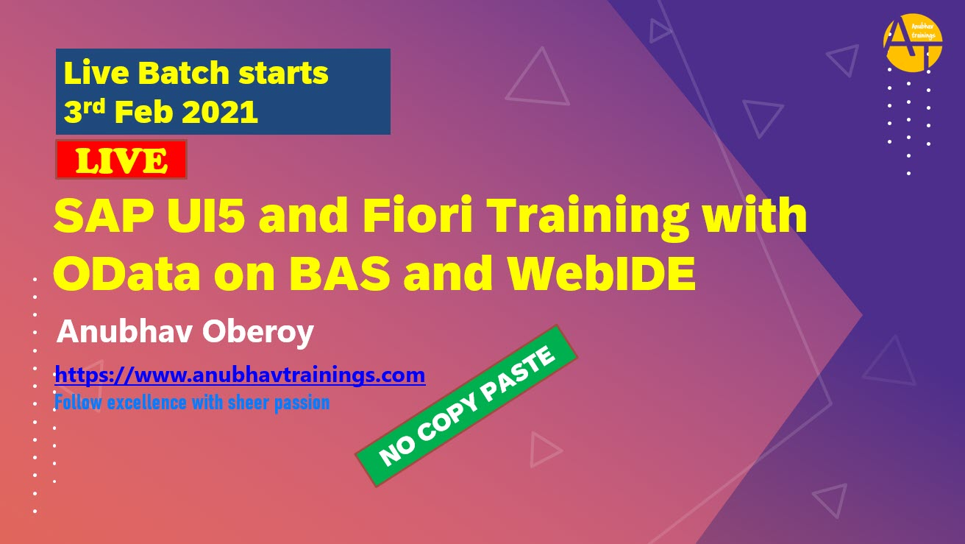

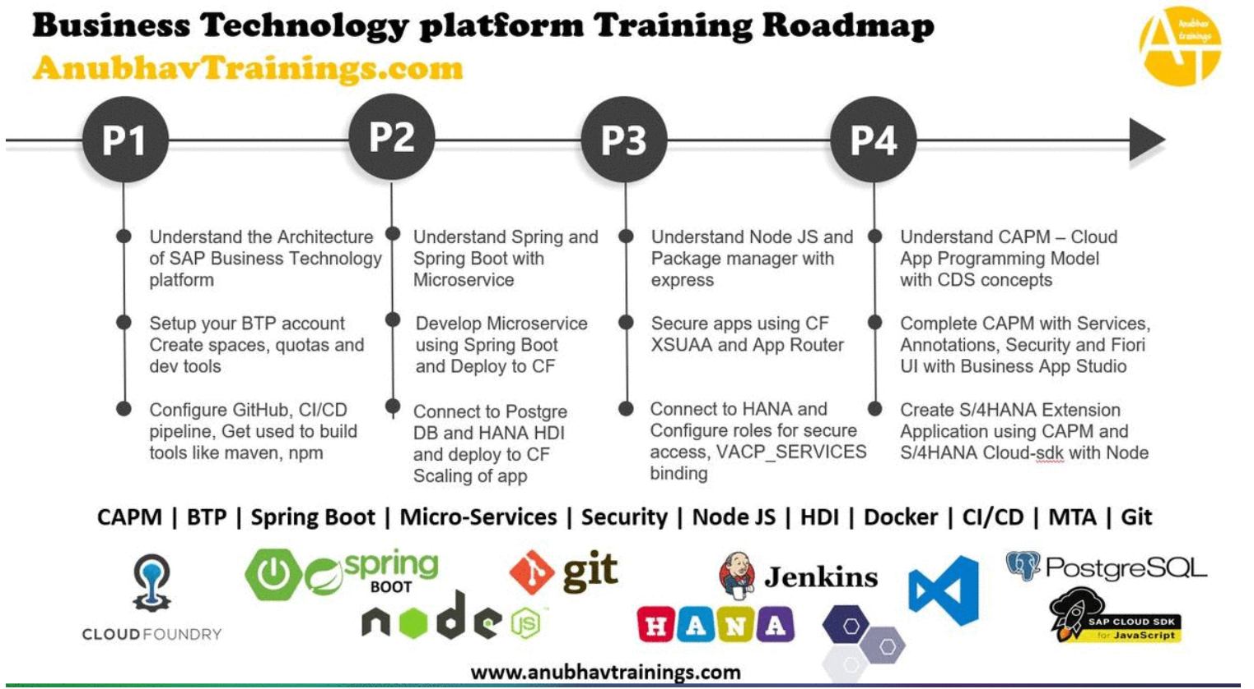
More from AnubhavTrainings.com

Slide 14






We’re committed to empower you to be
#FutureReady
through powerful training solutions.
We build the workforce of the future.
250+
Corporate Clients
30,000+
Learners Trained
25000+
Learners Placed
FREE WEBINARS
Sign up for free webinars with industry experts every fortnight!
Enroll Now!

Slide 15
FREE WEBINARS
Sign up for free webinars with industry experts every fortnight!
Contact us today!
www.anubhavtrainings.com

